Slide 1
Information Management Concepts & Fundamentals
Information

Slide 2
Introduction
Information is increasingly important in our daily lives
Information storage is a central pillar of information technology.
A large quantity of digital information is being created every moment by individual and corporate consumers of IT.
This information needs to be stored, protected, optimized, and managed.
These data – what we know as information – enable them to make more accurate decisions.

Slide 3
Introduction
The right amount of information at the right time is a key factor for every organization.
We have become information dependents of the twenty-first century,
We living in an on-command, on-demand world
We need information when and where it is required

Slide 4
Introduction …
Despite the difficulties in obtaining information,
Managers need relevant information on which to base their;
planning,
control and
decision-making functions.
The increasing criticality of information amplifies the challenges in protecting and managing the data.

Slide 5
From Data to Information to Knowledge
Although data and information are sometimes used indiscriminately,
they do have different meanings.
Data: Pure and unprocessed – facts or figures without any added interpretation or analysis.
Data simply exists, there is no significance beyond its existence
OR
Non-random symbols that represent the values of attributes or events.

Slide 6
From Data to Information to Knowledge…
Data can be highly significant depending on the context.
It provides the raw material to build information,
it also has to be accurate.
for example
Handwritten letters,
a printed book,
a family photograph,
a movie on video tape, a bank’s ledgers, and
an account holder’s passbooks are all examples of data.

Slide 7
From Data to Information to Knowledge…
Facts obtained through reading, observation, calculation, measurement, etc.
Data becomes information when it is applied to some purpose and is adding value which has meaning for the recipient.
Example
taking sets of sales figures (data) and producing a sales report on them (information).
the same set of data can be used to produce different kinds of information,
depending on how it is applied and who applies it.

Slide 8
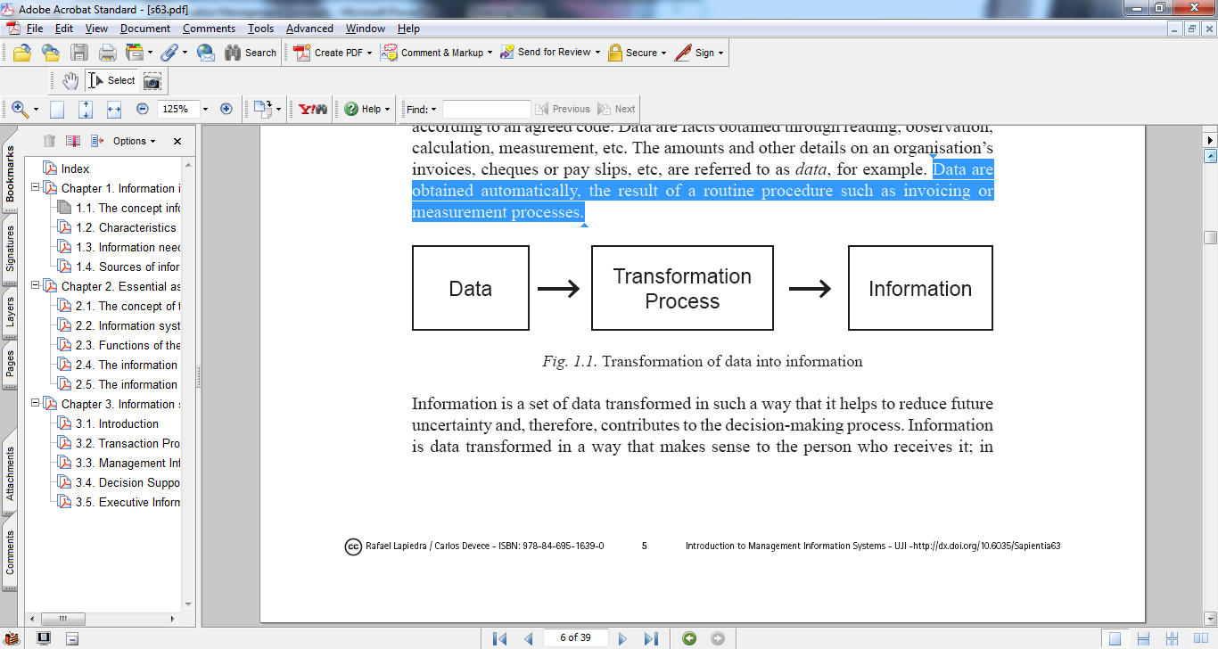

Slide 9
From Data to Information to Knowledge…
Data, whether structured or unstructured, does not fulfill any purpose for individuals or businesses;
Unless it is presented in a meaningful form.
Businesses need to analyze data for it to be of value.
Information: A set of data transformed in a way that it helps to reduce future uncertainty and,
Contributes to the decision-making process.
It is data transformed in a way that makes sense to the person who receives it;

Slide 10
From Data to Information to Knowledge…
It has a real or perceived value for that person when he or she acts or takes decisions.
The relationship between data and information is similar to that of raw materials and the finished product.
Information will be meaningful insofar as it provides useful raw material for taking a specific decision.

Slide 11
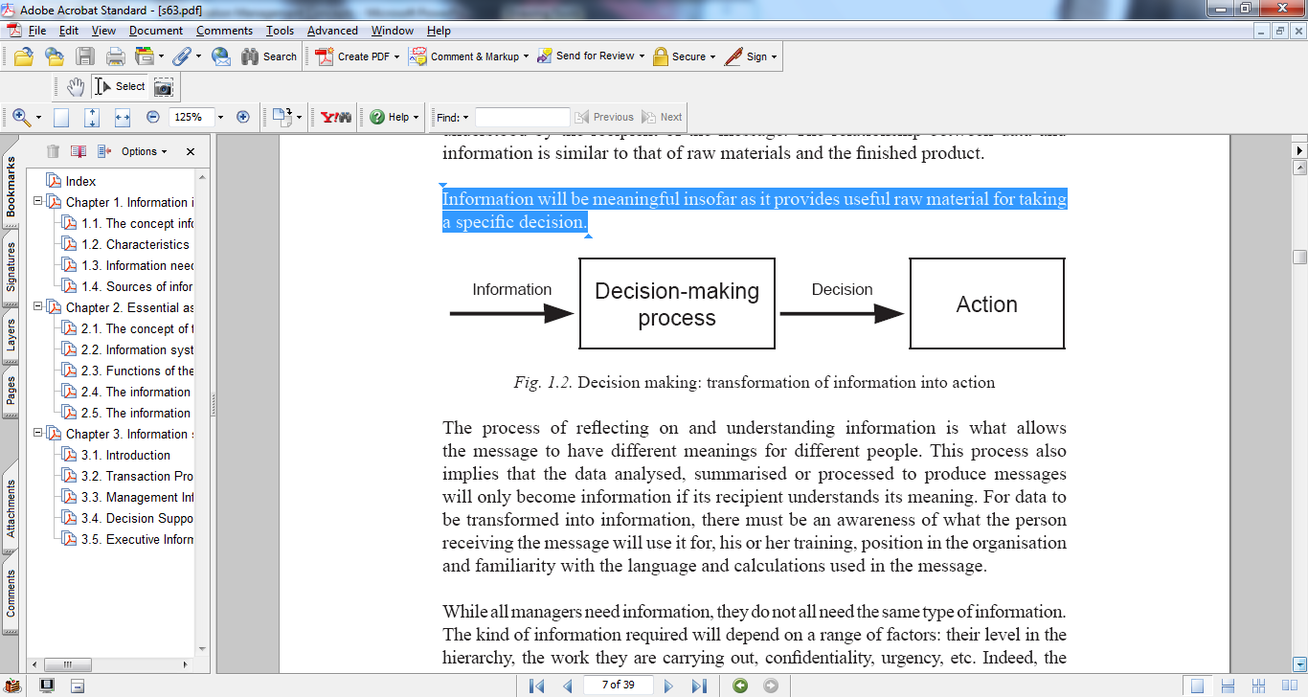
From Data to Information to Knowledge…

Slide 12
From Data to Information to Knowledge…
For data to be transformed into information,
There must be an awareness of what the person receiving the message will use it for,
While all managers need information, they do not all need the same type of information.
The kind of information required will depend on a range of factors:
their level in the hierarchy,
the work they are carrying out,
confidentiality,
urgency, etc.

Slide 13
From Data to Information to Knowledge…
The usefulness of information is a debatable point, and
what for one person is information, for another it could be data.
It reduces uncertainty and affords the recipient something he or she did not know previously.
Information is one of many company resources, alongside
Capital, raw materials and labor,
No company is viable without information.

Slide 14
From Data to Information to Knowledge…
Information supports day-to-day business operations
Decision making and
Almost any function in a business firm
Although one cannot feel, smell or touch information,
It is a critical element to any modern business

Slide 15
From Data to Information to Knowledge
Knowledge – Information and/or data to which expert opinion, skills and experience is added.
It is an important part of organizational assets.
It combines information, experience and insight into a mix that is unique to every employee
Awareness or familiarity gained by experience (of a person, fact, or thing)
If knowledge is applied within the day-to-day task,
It will lead to (positive) change in behavior.

Slide 16
From Data to Information to Knowledge…
Applying knowledge leads to wisdom (intelligence).
It has to do with:
Insights about life,
Moral responsibility about our self-knowledge, and
Mastery of our passions and pitfalls.

Slide 17
Summary
Assume that you’re trying to decide on a specialist holiday for photography enthusiasts.
Stage 1: collect lots of brochures on photography holidays.
This is your basic data store.
Stage 2: work through the brochures, filtering out what you don’t want by applying your own criteria to them.
You can now apply your information and make a decision on where to go on your holiday.

Slide 18
Summary
Stage 3: you go on your holiday and build your knowledge from testing your actual experience of the holiday against the information you had when you booked it.
This knowledge can be kept to yourself (tacit) or
you can share it by reporting back to your local photography club (explicit).

Slide 19
Wisdom
The knowledge and experience needed to make sensible decisions and judgments

Slide 20
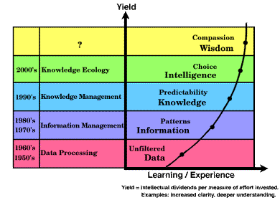
Learning Journey

Slide 21
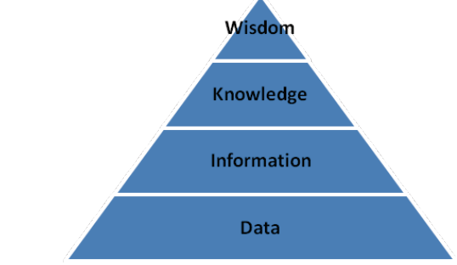
Data-Information-Knowledge-Wisdom Pyramid

Slide 22
Data-Information-Knowledge-Wisdom Pyramid…
Generally,
Data are the product of observations, and are of no value until they are processed into a usable form.
Information is contained in answers to questions.
Knowledge - further refines information by making “possible the transformation of information into instructions.
“wisdom” - an ability to see the long-term consequences of any act and evaluate them relative to the ideal of total control (omnicompetence)

Slide 23
Data-Information-Knowledge-Wisdom Pyramid…
Each step answers different questions about the initial data and adds value to it.
The more data is enriched with meaning and context, the more knowledge and insights is got
it helps to take better, informed and data-based decisions.

Slide 24
Forms of Information
Internal and external
Information generated inside the organization and information generated outside.
External intelligence and research may be incorporated into internal reports, and
Issues arising from internal reports may stimulate external market research.

Slide 25
Forms of Information…
Electronic and hard copy (paper-based), and spoken.
Electronic: Processed and accessible through computing technology
Hard copy: printed version of information on paper
Spoken: word of mouth
Most people also use conversation with others for information.

Slide 26
Qualities of information
Experience shows that good information should present the following qualities:
Relevance: Information should increase knowledge and
Reduce uncertainty surrounding the problem under consideration.
Accuracy: Information must be sufficiently accurate for managers’ purposes.
Completeness: All the information required to take a decision would be available;

Slide 27
Qualities of information
Source trustworthiness: Information source should have a proven track record of origin
Communication with the right person: Information should reach the right level in the organization.
Information providers must be aware of information needs
This is to ensure it goes straight to where it is required.
Punctuality: Good information is that which is delivered just when it is needed

Slide 28
Qualities of information…
Detail: Contains the minimum level of details for effective decision making.
Comprehension: Understood
Comprehension is what transforms data into information.

Slide 29
Characteristics of information
Information Has Value: Can have value within a given context that depends on its use or purpose.
Information is Volatile: People forget information relatively quickly
Value of Information Is Time Dependent: Some information is worthless after some time has passed.
Information Can be Enriched: Information can be provided with descriptive metadata .

Slide 30
Characteristics of information…
Information Can be Shared: Information, or pieces of information, can be shared during the execution of business processes or
As a result of meeting legal obligations to provide certain information to third parties.

Slide 31
Understanding information
Many factors intervene in understanding information:
User preferences. How the user wants the information displayed
Some people prefer information in graphs or charts, while others prefer a narrative description.
Previous knowledge. Comprehension is the result of memory in association with the received message.

Slide 32
Understanding information …
Environmental factors: Group pressure, available time and
Trust in the information system all influence comprehension.
Language: Information is codified in signs or messages.

Slide 33
Information Management
Information management (IM) is:
A conscious process by which information is gathered and
used to assist in decision making,
at all levels of an organization
The term ‘information management’ implies that information is a resource that can be managed.
Information as a resource can be compared with money as a resource.
Information comes in and goes out.

Slide 34
Information Management…
IM is concerned with the value, quality, and use of information
Aimed improving organizational performance.
The primary objective of IM is;
To ensure that the right information is available to the right person, in the right format at the right time.

Slide 35
Information Needs
The information needs of an organization is divided into three categories.
Operational information: Information needed to perform the day-to-day work within an organization
Control information: Specific information needed for managing an organization
Accountability information: Information on how operation and control proceed within an organization

Slide 36
Information Management Goals
To ensure that;
Quality information is created and provided
Decisions are documented
Information is available (captured, organized, accessible, maintained, preserved)
Information is protected in accordance with legislation and policy requirements
Information is disposed of in accordance with legislation and policy requirements

Slide 37
Roles & Responsibilities in Information Management
Manage information as a key corporate resource;
Plan the information needs of organizations;
Collect and create information to support the program/activity and information needs;
Identify, file and organize information for quick and easy retrieval;
Provide access to information and respect the information, and privacy, rights of others;
Retain and dispose of information appropriately;
Protect information and the privacy rights of others;

Slide 38
Roles & Responsibilities in Information Management…
Comply with information policy and legal requirements; and
Take responsibility for their performance in the management of information

Slide 39
Information Environment
The information environment consists of six components:
Information strategy: Set of principles that determine the information needs of an organization and how to achieve it.
Information staff: IT specialists who design, develop, train and coordinate the creation and use of information.
Information architecture: provides a guide to the structure and location of information within the organization.

Slide 40
Information Environment…
Information processes: describes how information work gets accomplished;
through determining information requirements, capturing, distributing and using information.
Information politics: arises from the distribution of the power that information bestows and the governance modes for its management and use
Information behavior and culture: concerned with; sharing information; handling information overload

Slide 41
Information Environment…
Behavior: understanding the way people search for and use information in various contexts
Culture is the pattern of behaviors and attitudes that express an organization’s orientation toward information
making information engaging so that the right people recognize and use the right information

Slide 42
Information use
Occurs when individual selects and processes information leading to a change in the individual’s capacity to make sense or to take action.
Based on the information need perceived by users, information use can be categorized as;
Enlightenment. Information is used to develop a context or to make sense of a situation.
Instrumental. Information is used so that the individual knows what to do and how to do it.

Slide 43
Information use…
Factual. Information is used to determine the facts of a phenomenon or event, to describe reality.
Confirmational. Information is used to verify another piece of information.
Projective. Information is used to predict what is likely to happen in the future.
Motivational. Information is used to initiate or sustain personal involvement, in order to maintain a particular course of action.

Slide 44
Information use…
Personal or political. Information is used to develop relationships; enhance status, reputation, personal fulfillment.

Slide 45
Information use outcome
The outcomes of information use can be regrouped into three categories as follows:
Task performance – enlightenment (making sense of a situation); instrumental (knowing what to do).
Self-efficacy – motivational (sustaining personal involvement); personal (enhancing status, reputation, personal fulfillment).
Social maintenance – personal or political (using information to develop relationships, to ‘get connected to others’).

